Slide 1
Natural Language Processing
Project 3
Joel, Janet, Clement

Slide 2


Problem statement
Can reddit to become an aggregator of conversations
Reddit now want to display organic conversations from its members, but also any publicly available conversation on the internet, and classified it under one of its existing subreddits.
They have hired us to run a "stage 0 testing" to evaluate whether such an algorithm would even be effective based sources from reddit itself, let alone importing from other sources.

Slide 3
Plan
Problem statement
Fetching data
Data cleansing
EDA
Features engineering
Modeling
Metrics review
Sentiment analysis
Conclusion

Slide 4
Getting the data
Using Reddit API
Size: each subreddit got scrapped 200 post x 30 iterations = 6000 posts
Data pre-EDA cleansing
Transform to lower
Remove empty posts
Handle emojis
Notes:
https://api.pushshift.io/reddit
Data pre-EDA cleansing
Transform to lower—-------------To make sure that all words get the same treatment from the model
Remove empty posts —----------They are non informative create noise
Remove emojis—----------------------Emojis mostly reflect a sentiment and are not needed for this stage 0

Slide 5
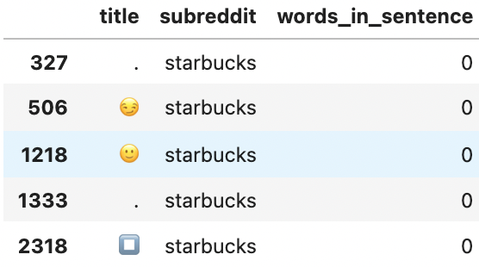
EDA
1. Most common words in each df
Tokenizing
Lemmatizing & Stemming (9498 columns vs 7381 columns)
Removing stop words
Checking similarity: Unigrams vs Bi-grams
2. Counting words
Check for min, max and mean word count on the individual datasets
Dropping the rows that contains no words in titles (Users include an emoji or punctuation in place of a word in title)
Plotting in WordClouds
3. Posts length in each df
Is there a pattern in length that may influence the model?
Notes:
Tokenizing —-----------------------------Quality of words will determine the model ability to classify accurately
Lemmatizing & Stemming - shortening the words to their root, eliminating duplicates but losing quality
Removing stop words—---------------Stop words are enhanced with brand names and removed from the corpus
2. Posts length in each df
Is there a pattern in length that may influence the model?

Slide 6
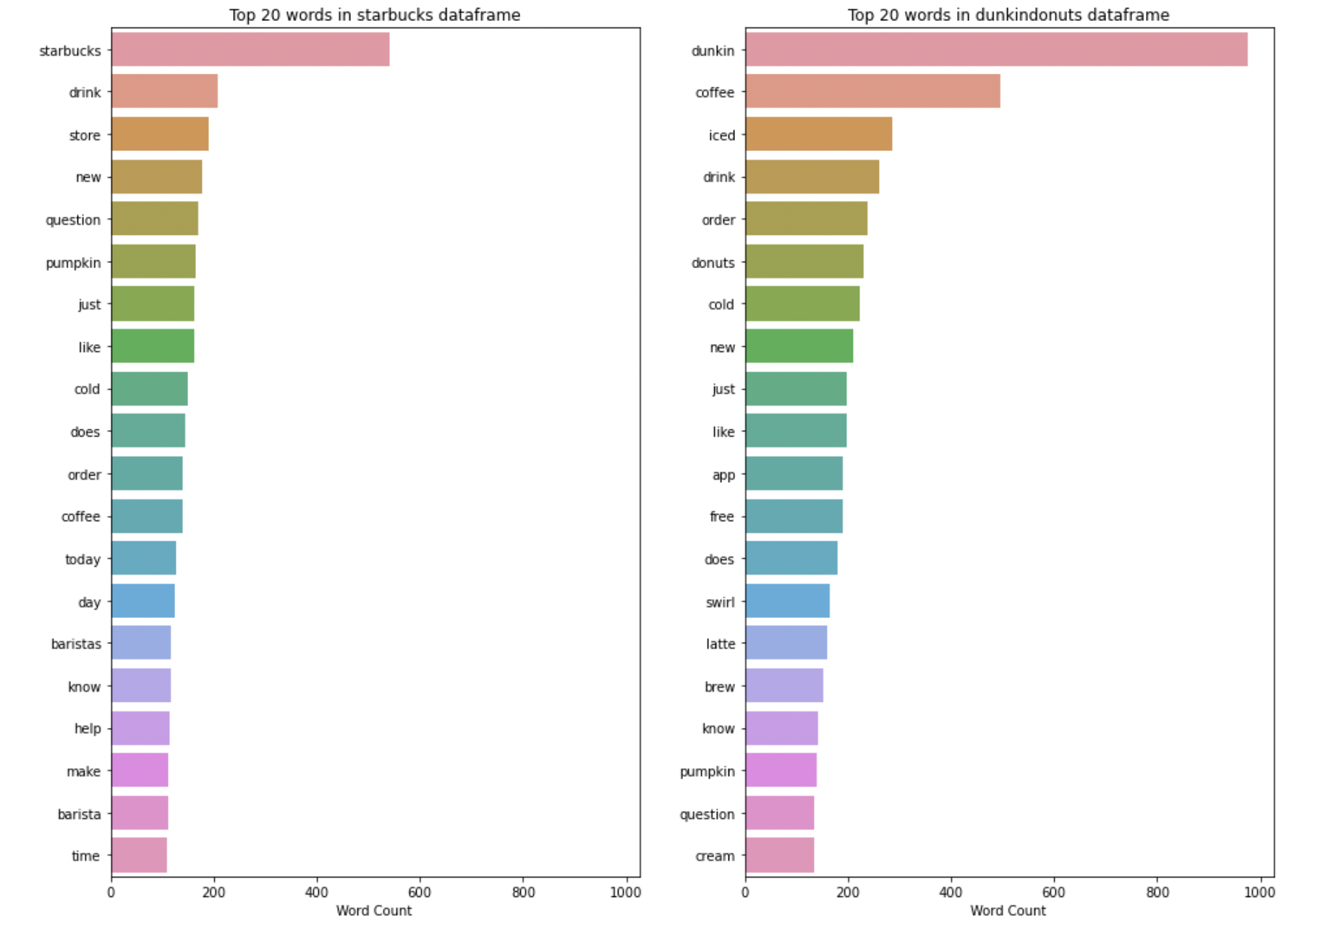
Visualization on unigram

Slide 7
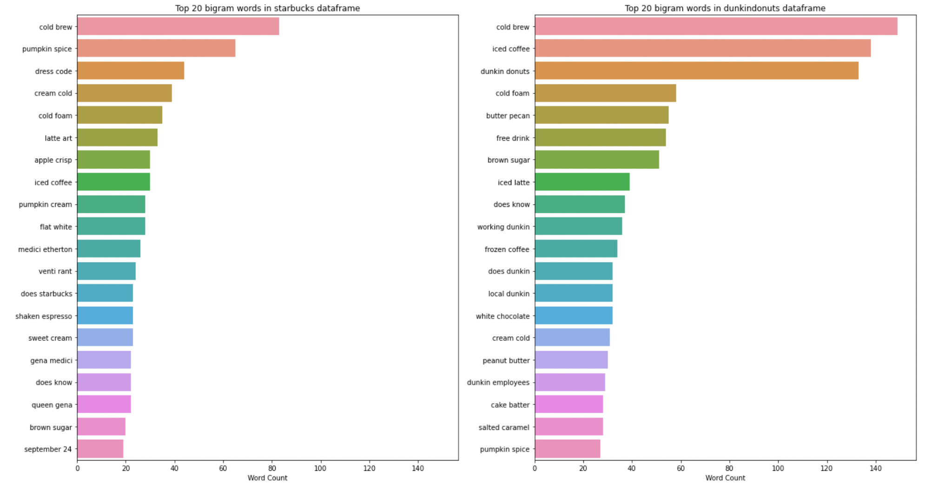
Visualization on Bigrams

Slide 8
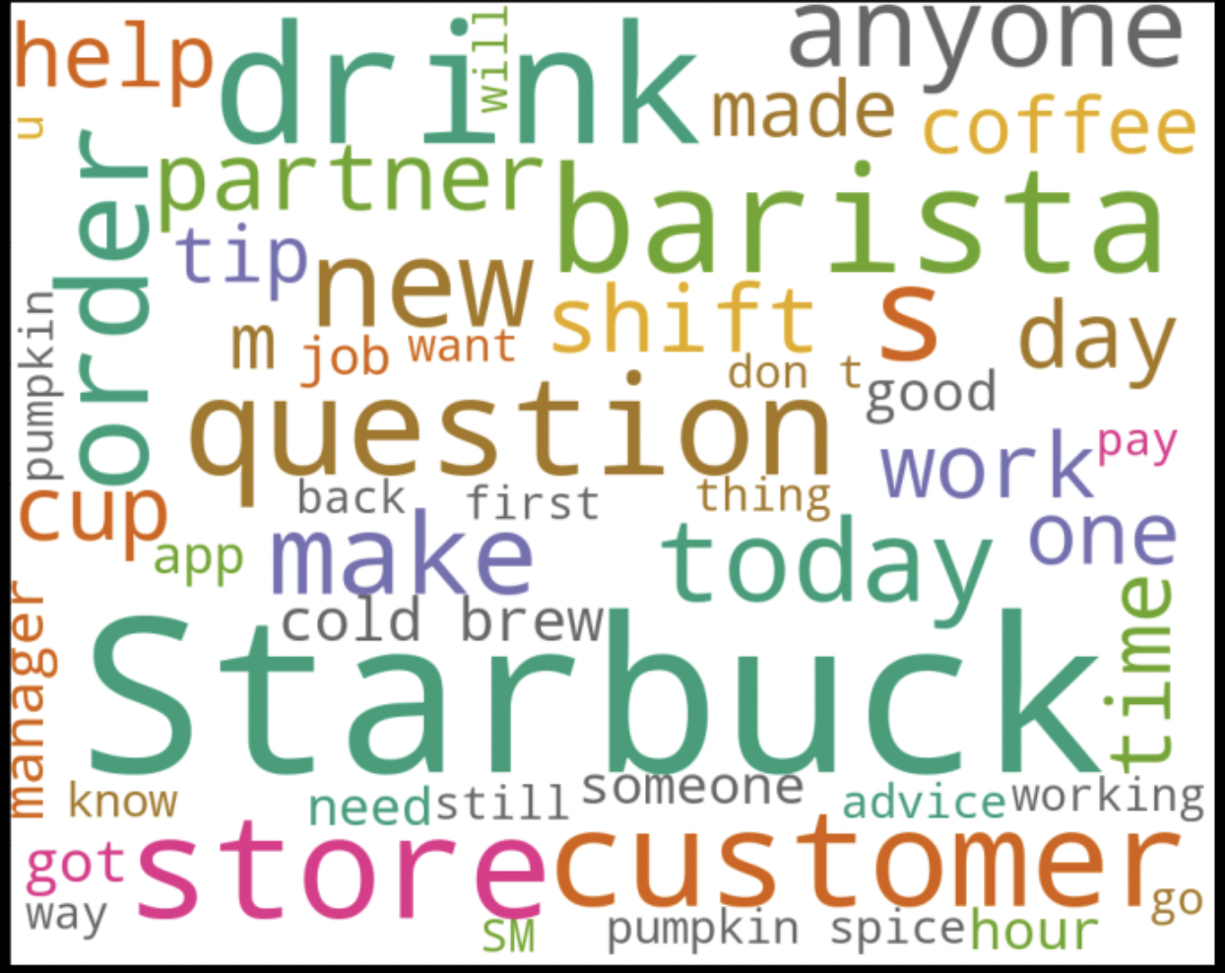
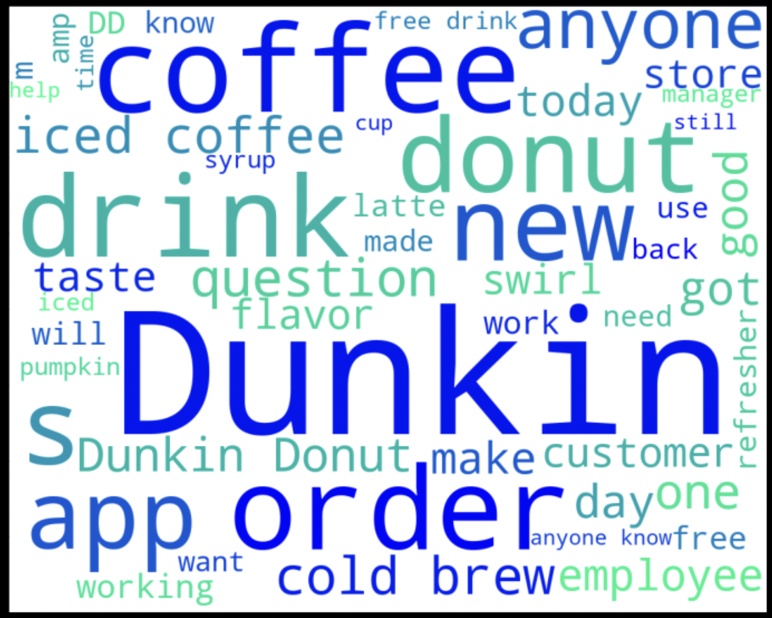
WordCloud on raw title text

Slide 9
Preprocessing
Converting text in title to lowercase
Removing numbers
Removing URLs
Removing punctuation
Applying stemming
Remove stop words, including brand names and other miscellaneous words like ‘tall’, ‘grande’, ‘venti’ all of which describes the cup size of Starbucks

Slide 10
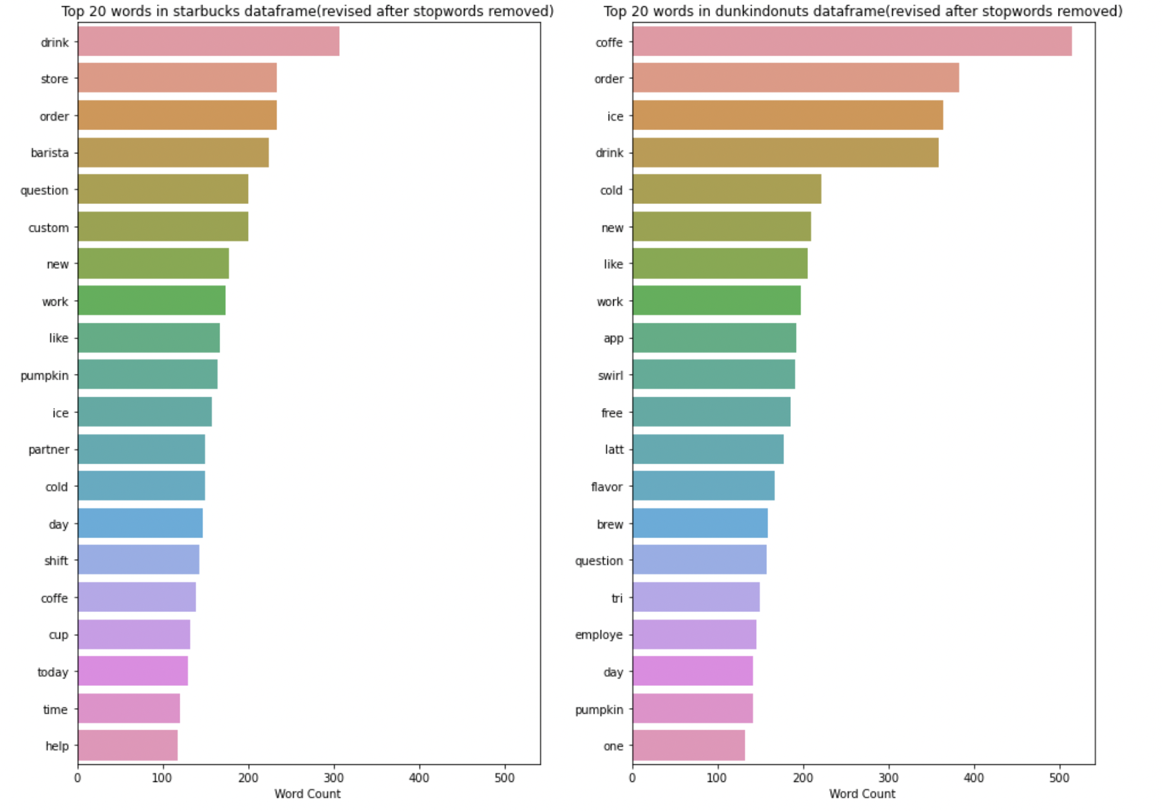
Visualization on unigram (After preprocessing)

Slide 11
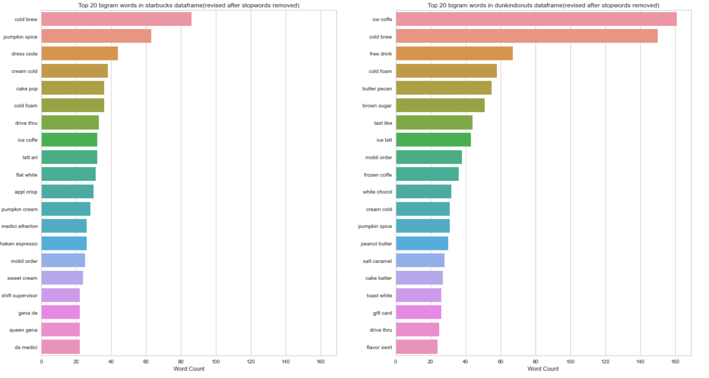
Visualization on Bigrams (After preprocessing)

Slide 12
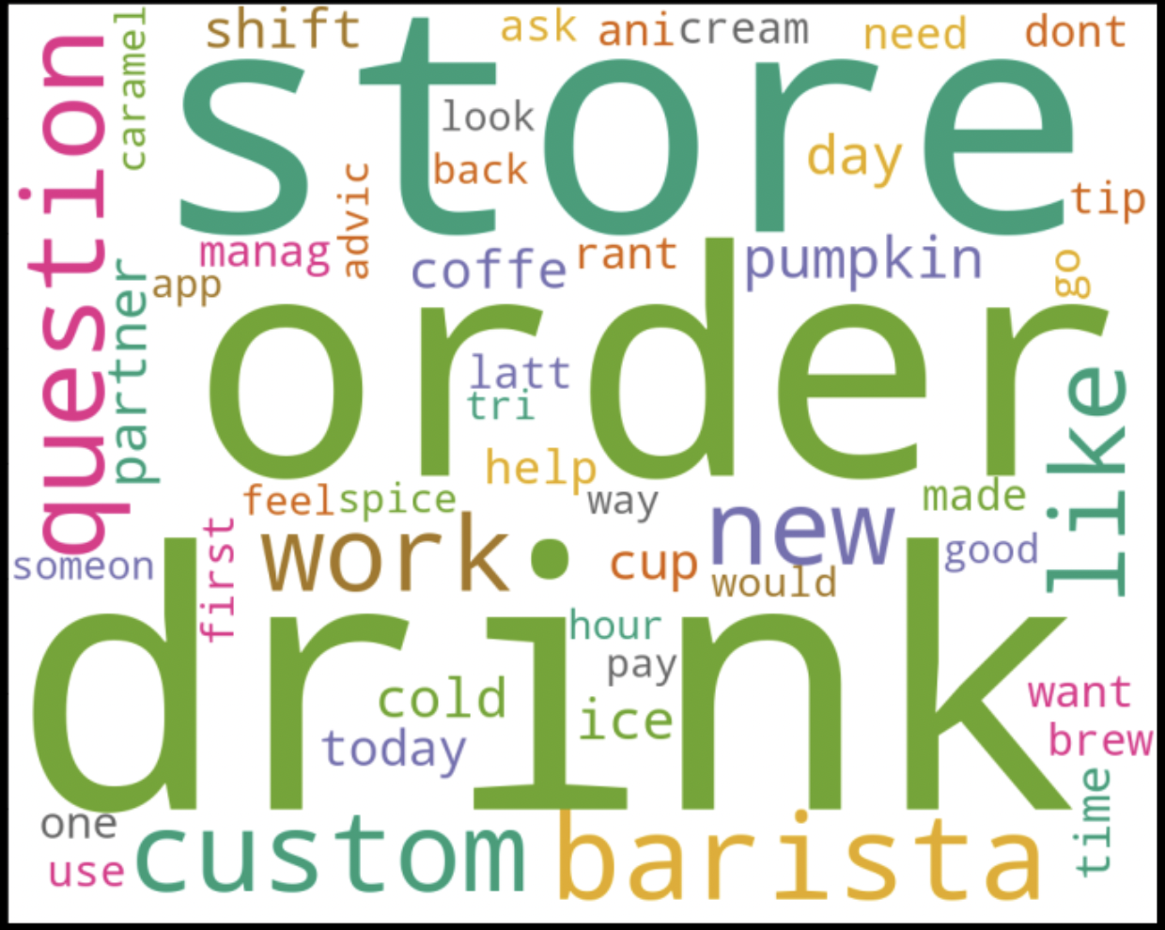
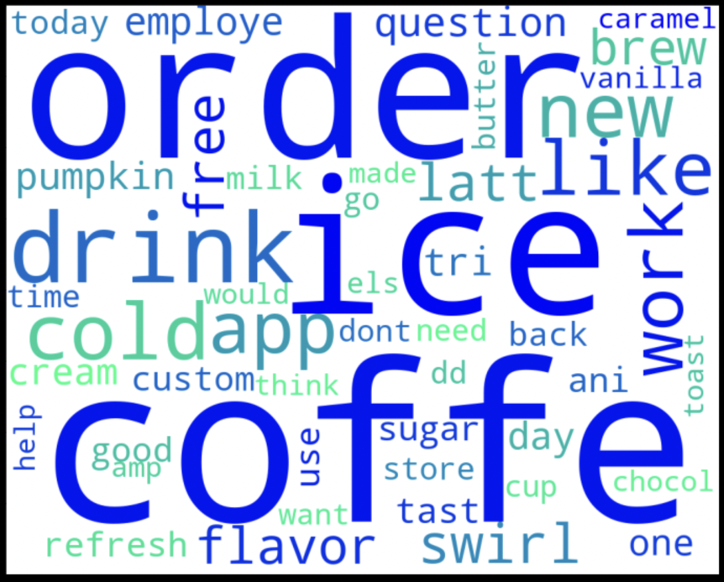
WordClouds post-stop words removal

Slide 13
Classification model metrics
Choices : Accuracy, Recall, Precision, F1
Chosen: Accuracy
Target variable is balanced (0.50 each)
Consequences of False Positive and False Negative is more or less the same
No prioritizing of True Positive/ Negative or False Positive/ Negative required in this case

Slide 14
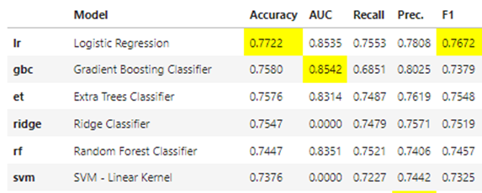
Modeling
Baseline model = Null model = 0.50
Compare all models in PyCaret Library
Top models:
Logistic Regression
Gradient Boosting Classifier
Extra Trees Classifier
Tune the hyperparameter
Notes:
Steps:
Train/test split data
Perform TF-IDF Vectorizer on Dataset (min_df = 0.001, max_features = 2000, ngram_range = (1,2))
Using Pycaret to compare and get best model
Model 1 MNB
Model 2 Extra tree
Model 3 Random Forest
Pipeline / params tuning/ GSCV
TF-IDF

Slide 15
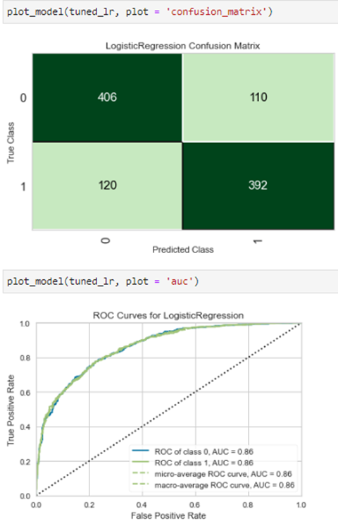
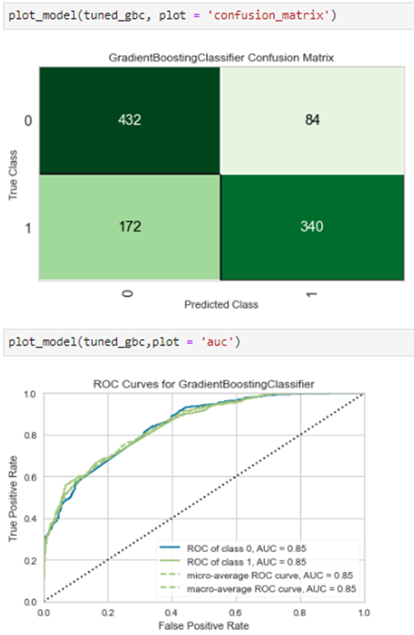

Models EDA
Notes:
Feedback: to include/ compare train plot besides test

Slide 16
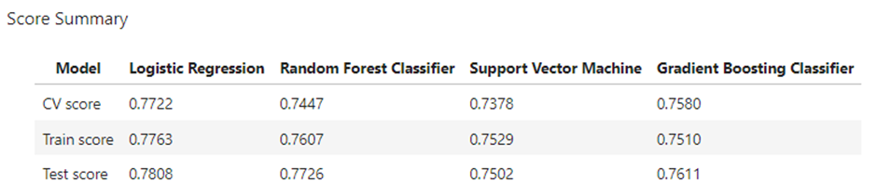
Final model and Evaluation
Logistics Regression gives best accuracy of 0.78.
Well-fitted
Interpretable
Computational cheaper
Suitable for binary classification problem

Slide 17
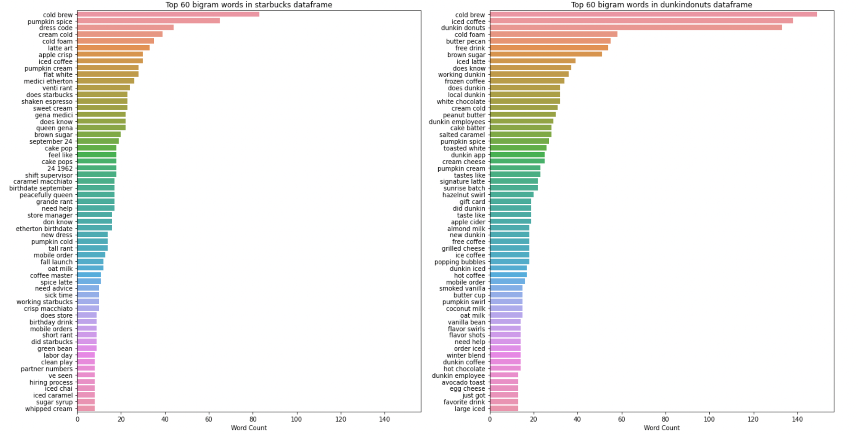
Sentiment Analysis - on Hot Topics
Dunkin’:
Cold brew
Iced coffee
Dunkin donuts
Starbucks:
Cold brew
Pumpkin spice
Dress code
Both:
Reward
Service
Notes:
reward (free drinks, free beverages, point)
service (mobile order, drive through, staff)

Slide 18
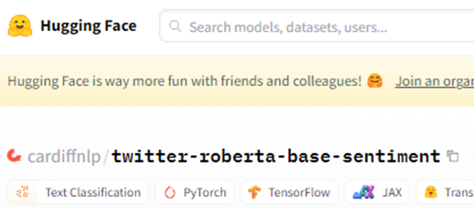
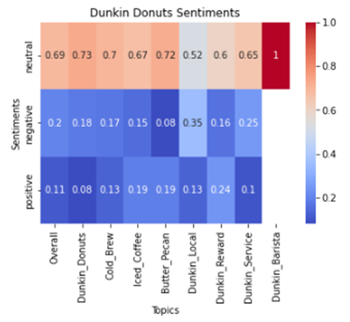
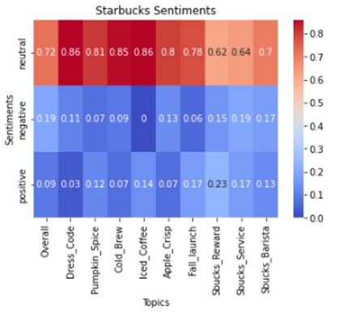
Sentiments
Majority posts seem neutral - Questions, Discussions
Well-received topics : Rewards (free drinks, free beverages, points)
Negative topics: Services (mobile order, app, staffs)
Notes:
Feedback: to tune by user-defined parameter

Slide 19
Project conclusion
We have obtained a reliable classifier to differentiate between 2 posts on reddit;
Recommendation:
We can use Logistic Regression as our model to allocate subreddits with satisfying accuracy.
We can add on Sentiment Analysis feature to ease the navigation inside a subreddit for HR | marketing business development teams
However
To accurately classify a post coming from anywhere on the internet will prove way more difficult
Notes:
Post

Slide 20
Future works
Gathering more data - fine tune model and enable time-series analysis
Text-pre-processing steps
Improving on our models training ( Gridsearch/ vectorizers etc…)
Stacking models to make predictions that have better performance than any single model in the ensemble
Notes:
Contractions: I’ve replaced contractions with their longer forms such as “isn’t”: “is not”, “can’t”: “cannot“. To do so, I’ve imported contractions list
Remove special characters: I’ve cleaned the data from any special character such as double quotes, punctuation, and possessive pronouns.
Stacking or Stacked Generalization is an ensemble machine learning algorithm.
It uses a meta-learning algorithm to learn how to best combine the predictions from two or more base machine learning algorithms.
The benefit of stacking is that it can harness the capabilities of a range of well-performing models on a classification or regression task and make predictions that have better performance than any single model in the ensemble.

